Slide 1
Supervised Learning
x₂
x₁

Slide 2
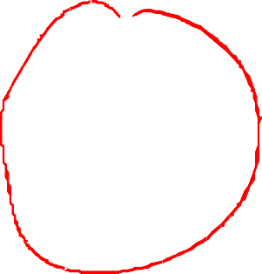

Unsupervised Learning
x₂
x₁

Slide 3
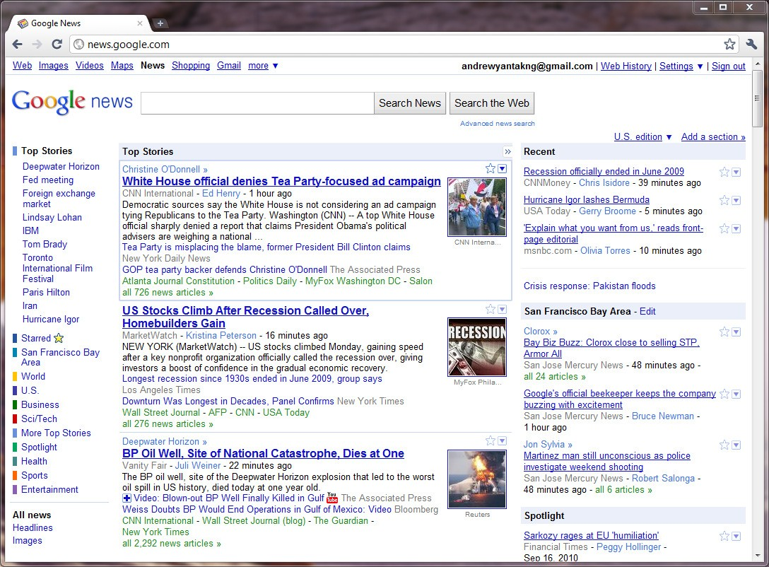

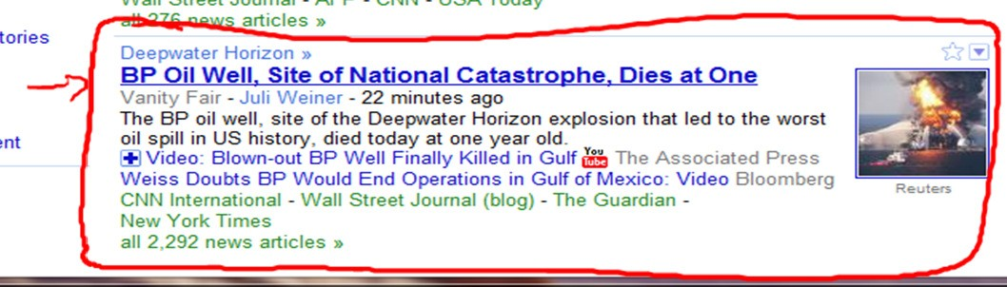
Andrew Ng

Slide 4

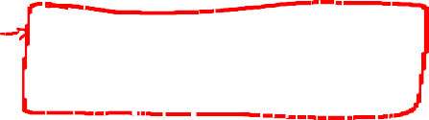
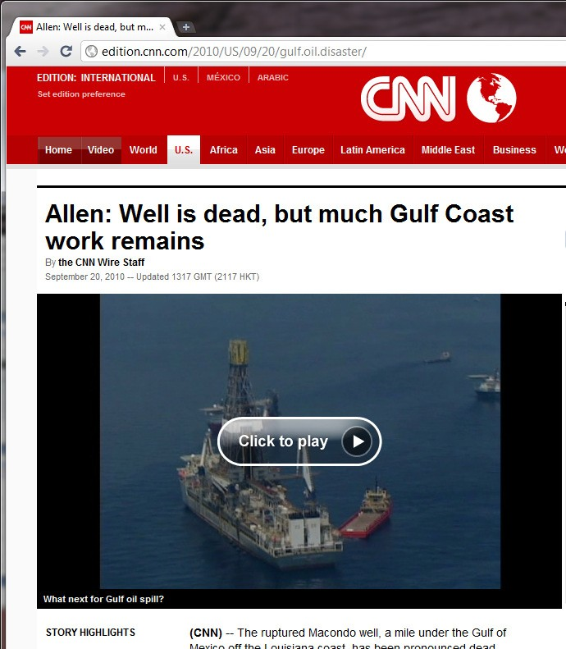
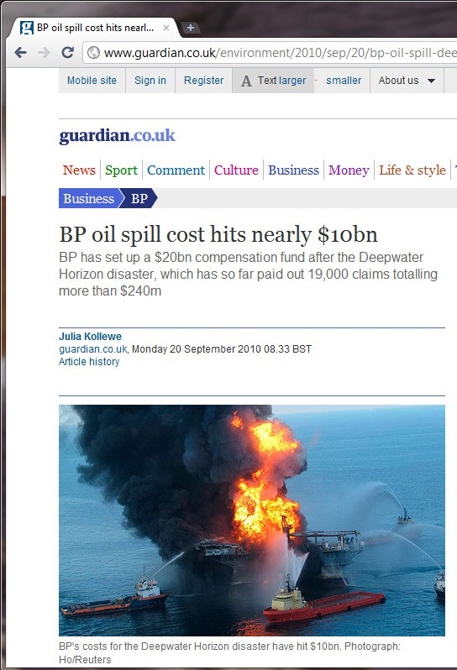
Andrew Ng

Slide 5
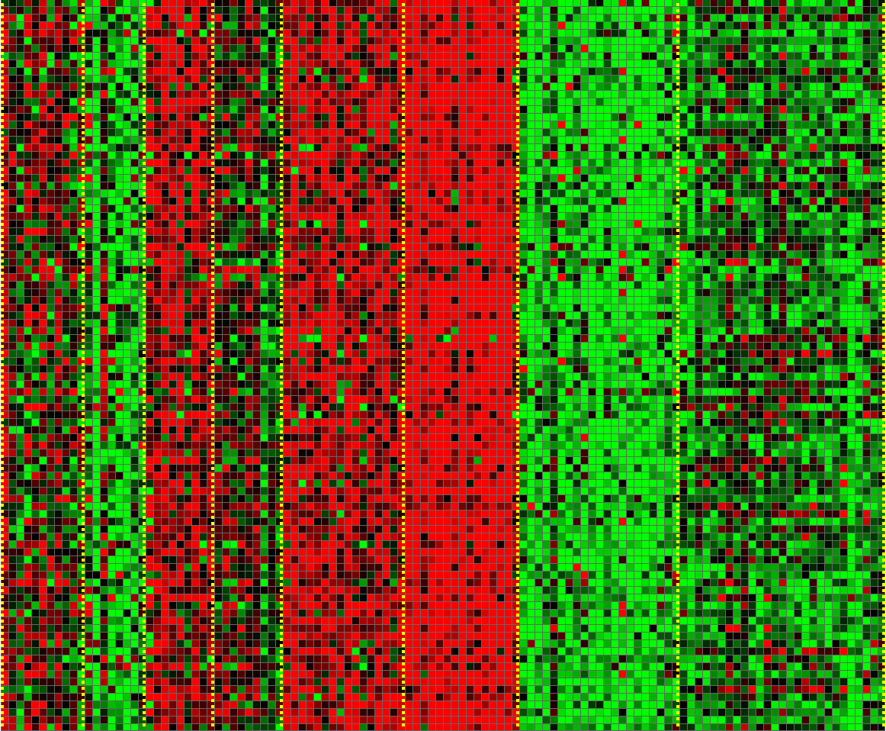

Genes
Individuals
[Source: Daphne Koller]

Slide 6
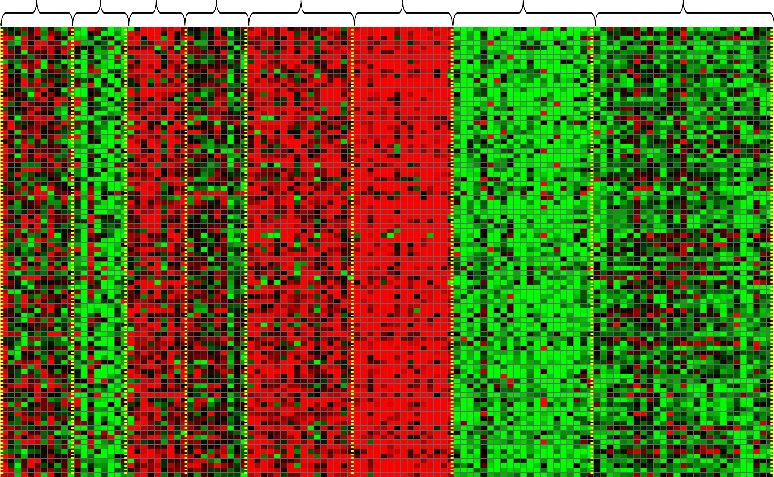
Genes
Individuals
[Source: Daphne Koller]

Slide 7



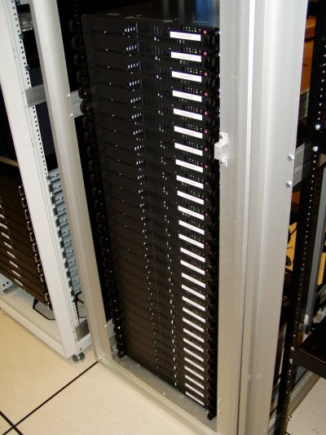
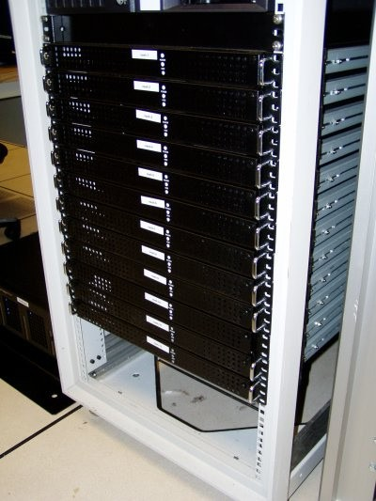

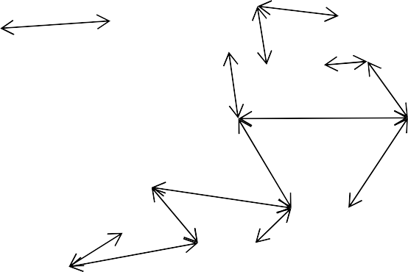
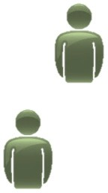








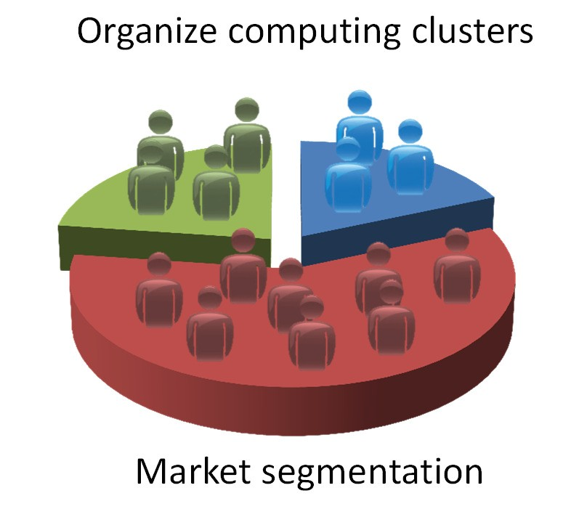
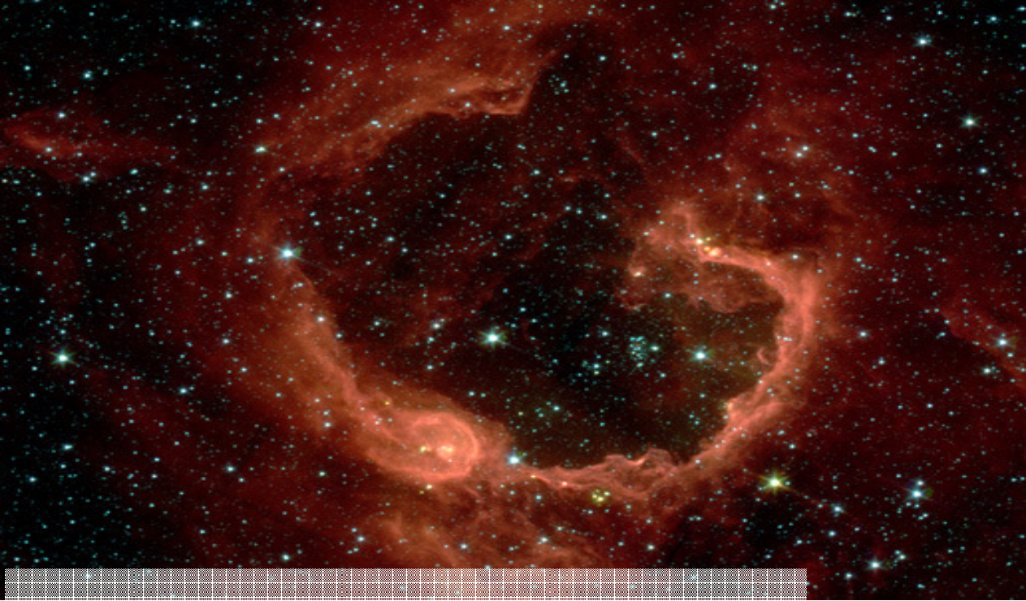



Social network analysis
Organize computing clusters
Image credit: NASA/JPL-Caltech/E. Churchwell (Univ. of Wisconsin, Madison)
Market segmentation
Astronomical data analysis
Andrew Ng

Slide 8

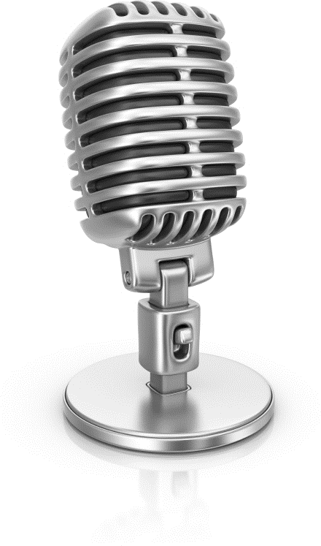

Cocktail party problem
Speaker #1
Microphone #1
Speaker #2
Microphone #2
Andrew Ng

Slide 9
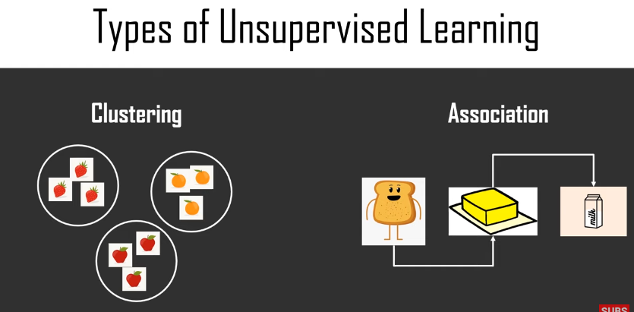

Slide 10
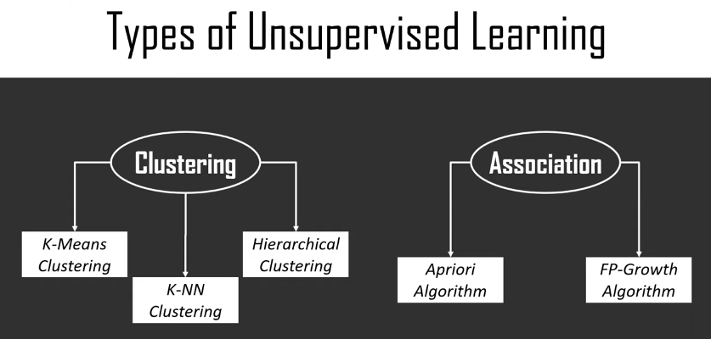

Slide 11
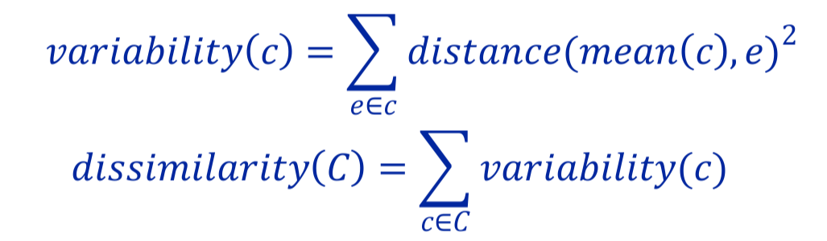
Clustering Is an Optimization Problem
Why not divide variability by size of cluster?
Big and bad worse than small and bad
Is optimization problem finding a C that minimizes
dissimilarity(C)?
No, otherwise could put each example in its own cluster
Need a constraint, e.g.,
Minimum distance between clusters
Number of clusters

Slide 12
Two Popular Methods
Hierarchical clustering
K-means clustering

Slide 13
Hiearchical Clustering
Start by assigning each item to a cluster, so that if you have N items, you now have N clusters, each containing just one item.
Find the closest (most similar) pair of clusters and merge them into a single cluster, so that now you have one fewer cluster.
Continue the process until all items are clustered into a single cluster of size N.
What does distance mean?

Slide 14
Linkage Metrics
Single-linkage: consider the distance between one cluster and another cluster to be equal to the shortest distance from any member of one cluster to any member of the other cluster
Complete-linkage: consider the distance between one cluster and another cluster to be equal to the greatest distance from any member of one cluster to any member of the other cluster
Average-linkage: consider the distance between one cluster and another cluster to be equal to the average distance from any member of one cluster to any member of the other cluster

Slide 15
Example of Hierarchical Clustering
 | BOS | NY | CHI | DEN | SF | SEA
BOS | 0 | 206 | 963 | 1949 | 3095 | 2979
NY |  | 0 | 802 | 1771 | 2934 | 2815
CHI |  |  | 0 | 966 | 2142 | 2013
DEN |  |  |  | 0 | 1235 | 1307
SF |  |  |  |  | 0 | 808
SEA |  |  |  |  |  | 0
{BOS} | {NY} | {CHI} | {DEN} | {SF} | {SEA}
{BOS, NY} |  | {CHI} | {DEN} | {SF} | {SEA}
{BOS, NY, CHI} |  | {DEN} |  | {SF} | {SEA}
{BOS, NY, CHI} |  | {DEN} |  | {SF, SEA}
{BOS, NY, CHI, DEN}
{BOS, NY, CHI}
{SF, SEA} Single linkage
{DEN, SF, SEA} Complete linkage
or

Slide 16
Clustering Algorithms
Hierarchical clustering
Can select number of clusters using dendogram
Deterministic
Flexible with respect to linkage criteria
Slow
Naïve algorithm n³
n² algorithms exist for some linkage criteria
K-means a much faster greedy algorithm
Most useful when you know how many clusters you want

Slide 17
K-means Algorithm
randomly chose k examples as initial centroids while true:
create k clusters by assigning each example to closest centroid
compute k new centroids by averaging examples in each cluster
if centroids don’t change: break
What is complexity of one iteration?
k*n*d, where n is number of points and d time required to compute the distance between a pair of points

Slide 18
How to Choose K
A priori knowledge about application domain
There are two kinds of people in the world: k = 2
There are five different types of bacteria: k = 5
Search for a good k
Try different values of k and evaluate quality of results
Run hierarchical clustering on subset of data

Slide 19
Deep unsupervised learning

Slide 20
